Slide 1
Brian Hansen brian@tf3604.com @tf3604
Remember Back When?
Temporal Tables in SQL Server 2016
SQL Saturday #662
Sioux Falls, South Dakota
19 August 2017
Notes:
Immediately before the session
Restore the bkhUtility database (Script 000)
Create the AutoTracker database (Script 010)
Create workload stored procedures (Script 011)
Start the workloads (Scripts 012a and 012b)
Verify the workload is running (Script 013)

Slide 2



Brian Hansen
15+ Years working with SQL Server
Development work since 7.0
Administration going back to 6.5
Fascinated with SQL internals
brian@tf3604.com
@tf3604.com
children.org
www.tf3604.com/temporal

Slide 3
Please be sure to visit the sponsors during breaks and enter their end-of-day raffles!
Remember to complete session surveys! You will be emailed a link after the event or you visit http://www.sqlsaturday.com/662/Sessions/SessionEvaluation.aspx
Event After Party
At Will’s Training Table (Formally Beef O’Bradys) near the Pentagon starting at 5:45 PM
Want More Networking and Training?
(605) SQL meets the 2nd Tuesday of every month. https://605sqlusergroup.sqlpass.org

Slide 4
















THANK YOU SPONSORS

Slide 5
Temporal Tables
Temporal = time-based = system versioned
Main purposes
Logging / Reversal of changes / Anomaly detection
Point-in-time business analytics / trends
Other purposes – but with complexity / caveats
Auditing
Change detection
Slowly-changing dimensions
Notes:
Most real-world databases have long have temporal components:
We keep track of when a row was inserted or updated
We want to know what changed – when, what, who?
Traditionally accomplished with triggers, CDC/CT or other methods (in the app, for instance)
These methods usually require some form of coding

Slide 6

The Scenario
Congratulations! You have just been awarded a lucrative contract with international automobile manufacturer FordoyotaBenz.
Notes:
Our assigned task is track ownership of automobiles for purposes of notifying customers of recalls.
I’ve never tracked automobiles, but I have tracked “things” before.
We’ll keep things really simple.
Just going to track automobiles, customers, dealers and who owns what car when.
Real world would probably need a breakdown of parts -> graph database?!

Slide 7
Demo
Automobile Tracking
Notes:
Scripts 020 through ???

Slide 8
Summary

Slide 9
Summary
Temporal querying: FROM TableName FOR SYSTEM_TIME _____
Point in time | AS OF '2017-02-06 11:30:00'
Full history | ALL
Between (‘start’ < EndTime AND ‘end’ >= StartTime) | BETWEEN '2017-01-11 18:55:04' AND '2017-05-06 11:30:00'
From (‘start’ < EndTime AND ‘end’ > StartTime) | FROM '2017-01-11 18:55:04' TO '2017-05-06 11:30:00'
Contained in (‘start’ >= EndTime AND ‘end’ <= StartTime) | CONTAINED IN ('2017-01-11 18:55:04', '2017-05-06 11:30:00')

Slide 10
Summary
select
cast('2017-06-10 10:10:00' as datetime2)
at time zone 'Central Standard Time' at time zone 'UTC';
select * from sys.time_zone_info;

Slide 11
Summary
New catalog objects
sys.periods (view)
sys.tables.temporal_type (column)
sys.tables.temporal_type_desc (column)
sys.tables.history_table_id (column)
sys.columns.generated_always_type (column)
sys.columns.generated_always_type_desc (column)

Slide 12
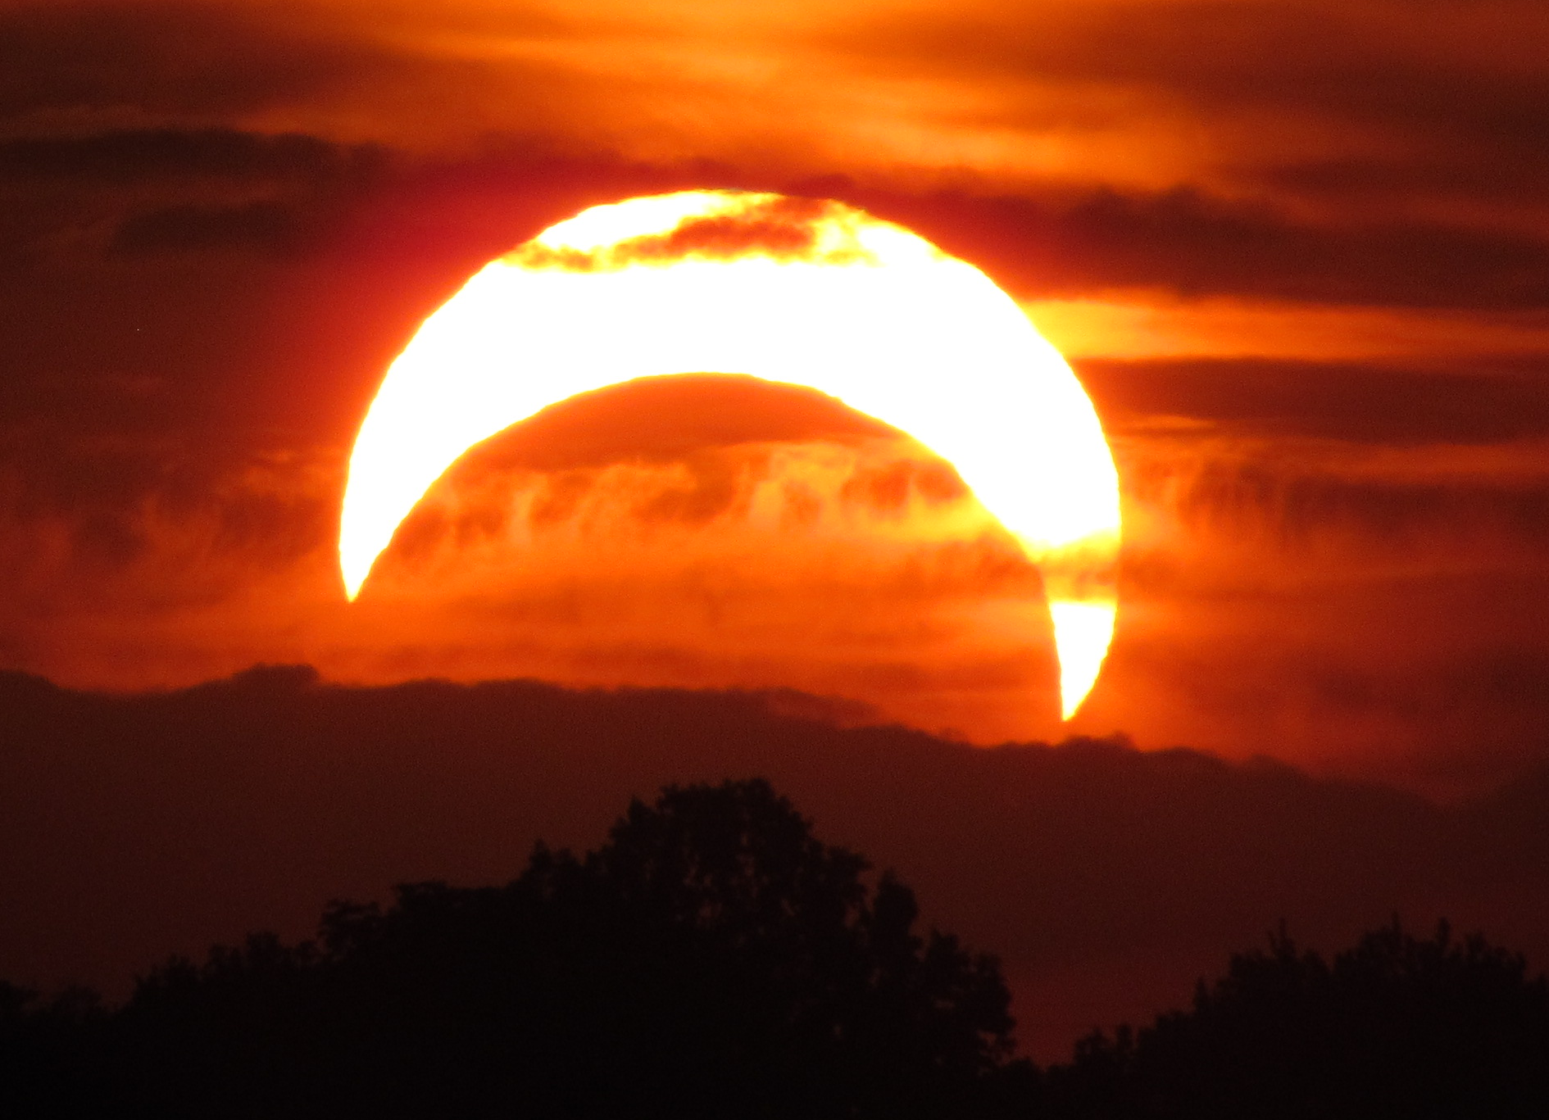
Thank You
This presentation and supporting materials can be found at www.tf3604.com/temporal.
Slide deck
Scripts
Sample database
brian@tf3604.com • @tf3604
Have a happy eclipse

